Slide 1
(RE)THINKING THE TEACHING PROFESSION IN SPAIN: CHALLENGES AND PROPOSALS FOR INITIAL AND CONTINUED TEACHER TRAINING
Conferința internațională PARTAJARE ȘI ÎNVĂȚARE PENTRU MENTORAT ÎN EDUCAȚIE ICSLME 2023
M. MOREY-LÓPEZ
J.VALLESPIR-SOLER
O. ÁLVAREZ-GARCÍA
10.11. 2023
Profesionalizarea carierei didactice - PROF – ID 146587 Proiect cofinanțat din Fondul Social European prin Programul Operațional Capital Uman 2014-2020

Slide 2
Index
Introduction: Teacher training in Spain
Transformation project for teacher training in the Balearic Islands
Future proposals
1
2
3

Slide 3
Introduction: Teacher training in Spain
1

Slide 4
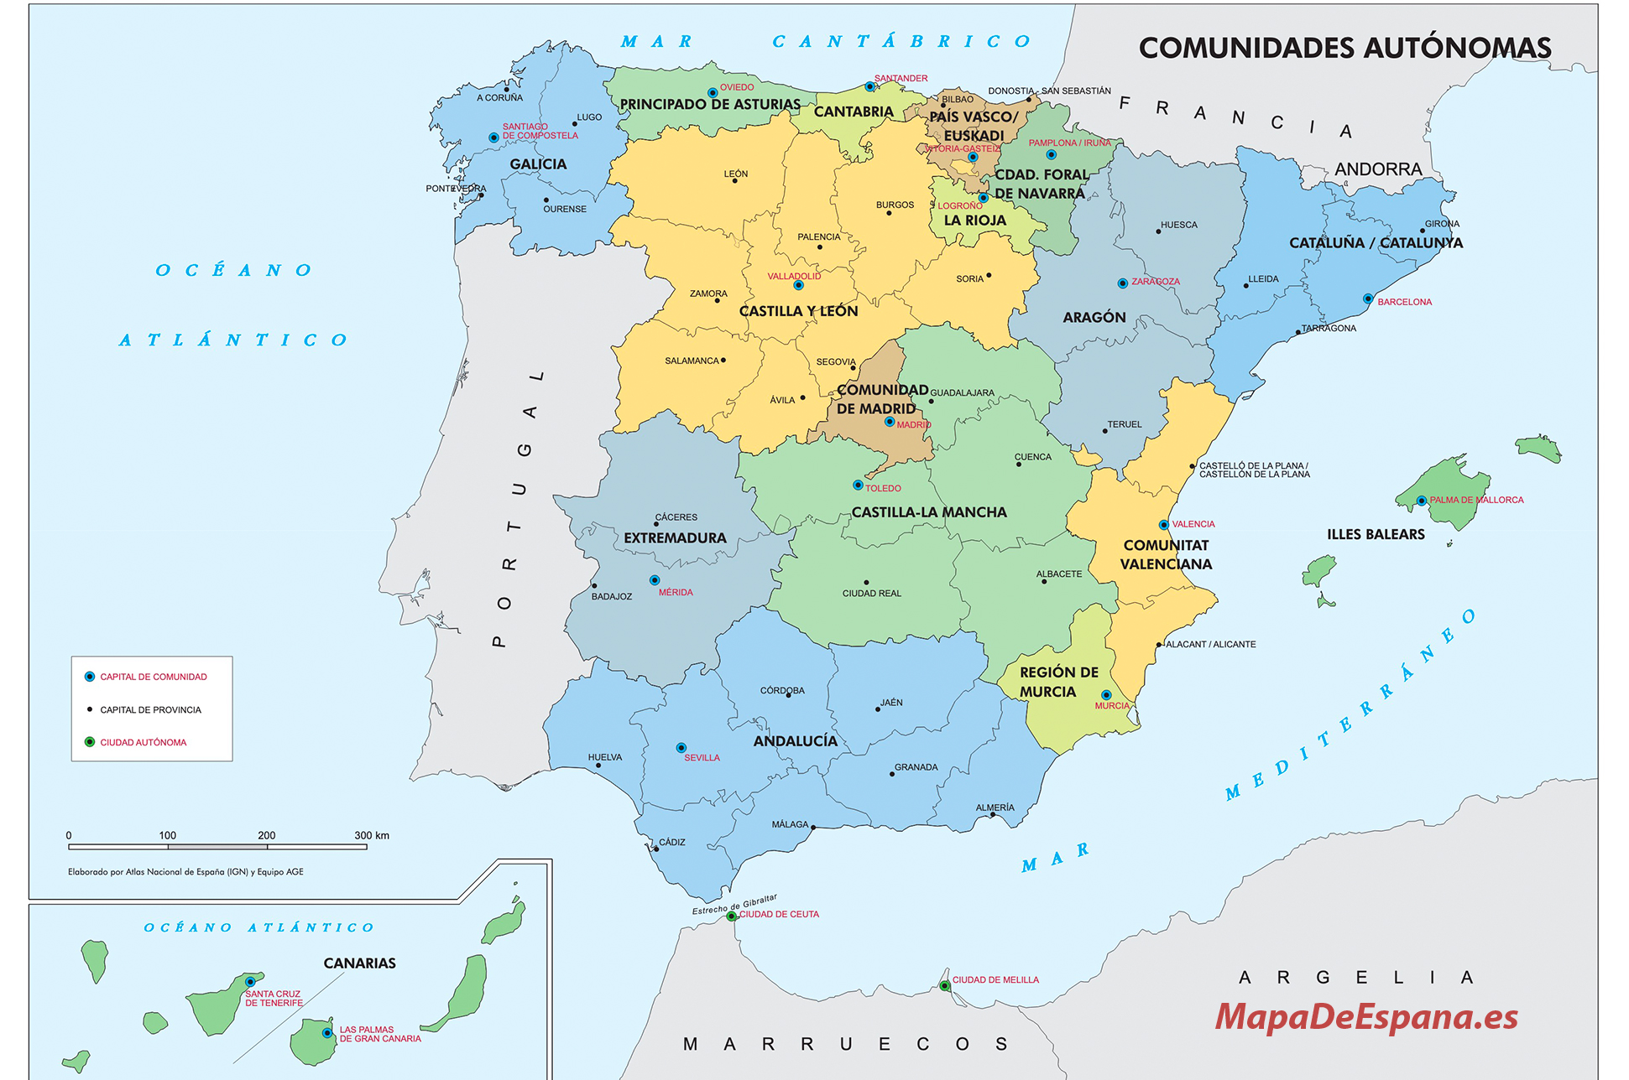

Slide 5
Initial Teacher Training
Organic Law on Education (LOE) (2/2006)
Preschool education
Primary Education
Secondary Education
Orden ECI/3854/2007
Orden ECI/3857/2007
Orden ECI/3858/2007
Environmental sustainability and Cultural diversity Competences: 2
Environmental sustainability and Cultural diversity Competences: 3
Environmental sustainability and Cultural diversity Competences: 2
Preeschool Education Degree
(4 years ↔ 240 ECTS)
Primary Education Degree
(4 years ↔ 240 ECTS)
Master's Degree in Teacher Training
1 year↔ 60 ECTS

Slide 6
Continuing professional development
Teacher training centers
Non-Formal Education
Courses, Seminars, Peer observation or Teacher networks;
few of them in relation to environmental education and intercultural education
Additional qualifications to achieve salary increases or better professional status

Slide 7
Transformation project for teacher training in the Balearic Islands
2

Slide 8
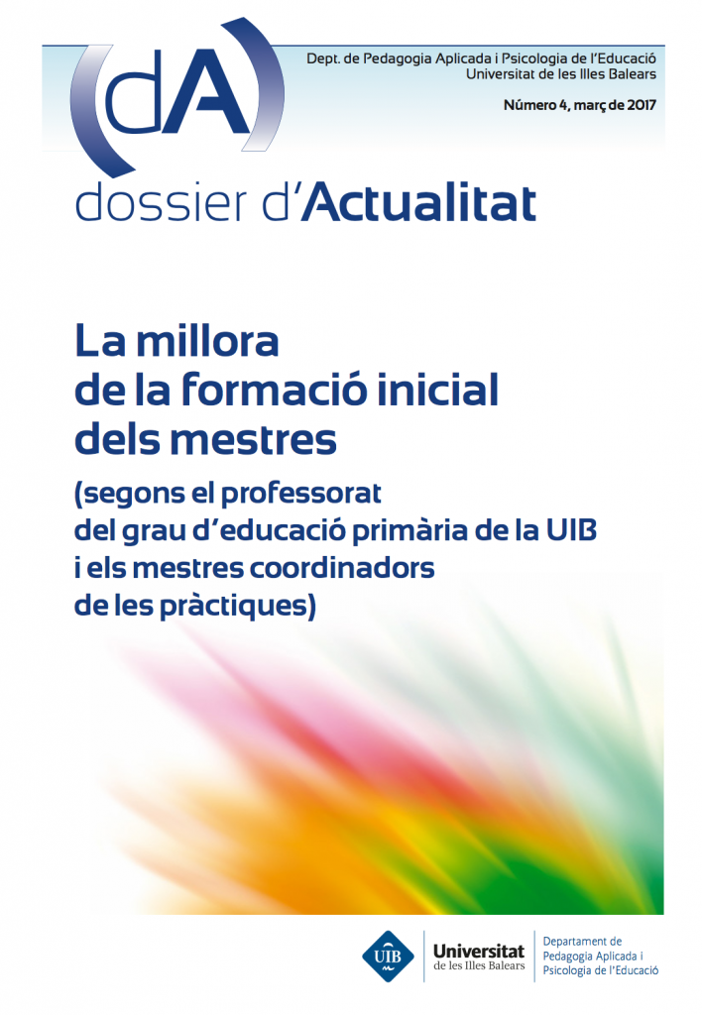
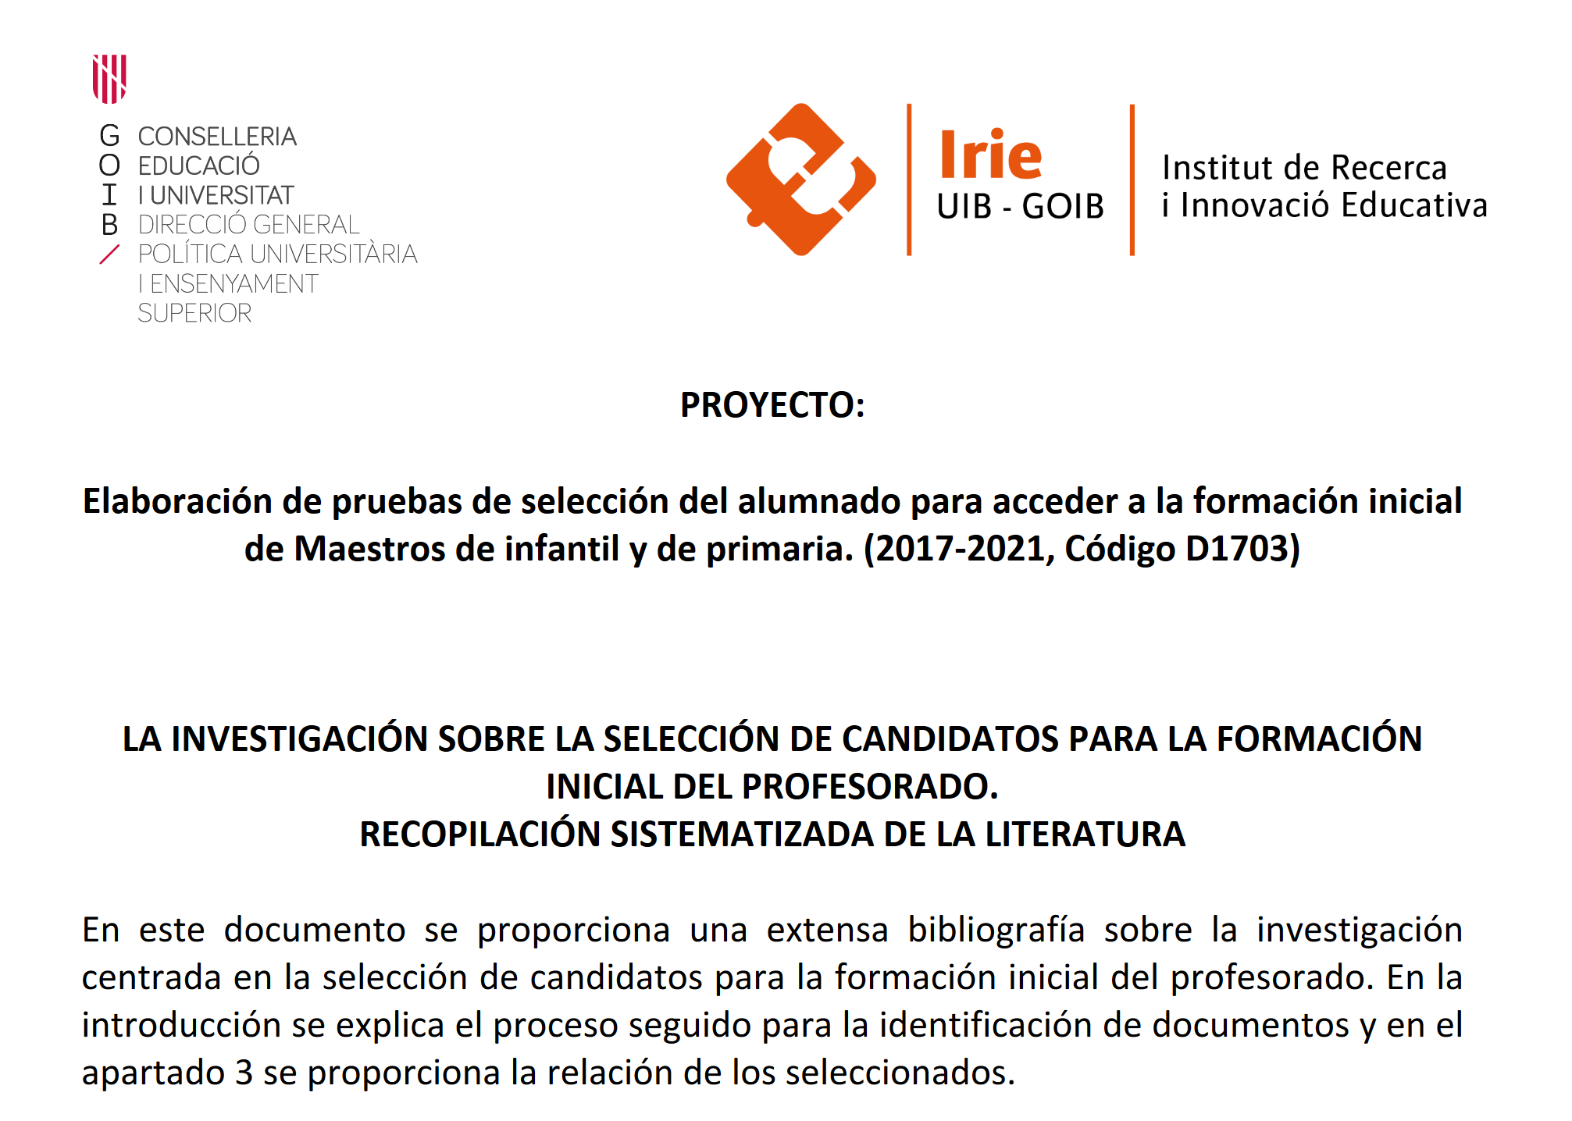
Teacher training improvement programme (Faculty of Education UIB)
2. Proposals in initial training (university professors and teachers)
1. Diagnosis of initial teacher training for preschool and primary education teachers
3. Analysis and systematization of admission tests for preschool & primary teaching careers

Slide 9
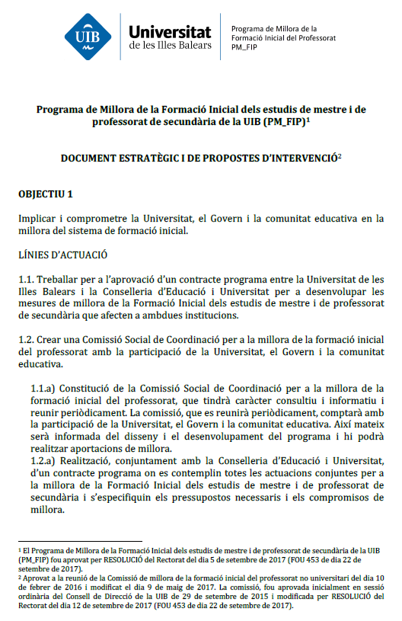
Transformation of the Master's Degree in Teacher Training
Preschool and primary education
1st and 2nd year
3rd and 4th year
4th year
Immersion in schools
Practicum
Conclusion:
DFP/MFP
Constructive support
CONSTRUCTIVE AND REALISTIC RESEARCH
REALISTIC LEARNING
CHALLENGE
Secondary education
1st semester
2nd semester
2nd semester + mentoring in centers
Reform Master’s Degree in Teacher Training
Involvement & training of teaching staff
Revision operation of Practicum & Master’s Final Project
Incorporation of mentoring into the process: involvement and collaboration of the educational administration & mentors training
Connection between pre-service & in-service training

Slide 10
Future proposals
3

Slide 11
Proposals for the future
LINE 1
LINE 2
Training & Assessment Plan for mentors
Transfer centre’s values with training & evaluation
Community
Collaboration with Education Administration
Relation among initial training & continuing professional development
LINE 3
LINE 4

Slide 12
Mulțumesc foarte mult
merce.morey@uib.cat
jordivallespir@uib.cat
olaya.alvarez@uib.cat

